Slide 1
ES 200: Autumn 2020
Environmental Studies : Science and Engineering
Module C: Solid Waste Management
Prof. Tabish Nawaz (Module C)
(tnawaz@iitb.ac.in)
Environmental Science and Engineering Dept.,
IIT Bombay
* Instructor In-Charge
(vsethi@iitb.ac.in)

Slide 2

Module C
Solid Waste Management
Lecture-3 Appendix
Functional elements: MSW Collection
Collection routing
Introduction to graph theory

Slide 3
Layout of Collection Routes
Divide the community into collection districts for effective SW collection.
Guidelines for common sense routing (heuristic routing):
Routes should not overlap and should be continuous.
On the job time (t_{net}) of all collection routes should be made equal as possible.
Congested areas should not be collected during rush hours.
As practicable as possible, collect a street on both sides.
As practicable as possible, select a consistent collection pattern.
For collection on steep streets, it is best for the vehicle to be collecting while moving downslope rather than upslope.

Slide 4
Layout of Collection Routes
Laying out routes is typically a 4 step process:
On a large-scale map, the following data should be plotted for each solid waste pickup point:
(i) location, (ii) number of containers, (iii) collection frequency, (iv) estimated quantity of wastes to be collected at each pickup location (when stationary container system).
Prepare data summaries
Estimate the quantity of waste to be collected from pickup locations serviced each day.
If a SCS is used, the number of locations that will be serviced during each pickup cycle should be determined.

Slide 5
Layout of Collection Routes
(3) Layout preliminary collection routes, staring from the dispatch station or where the collection vehicles are parked.
A route should be laid out that connects all the pickup locations to be serviced during each collection day.
The route should be laid out so that the last location is nearest the disposal site.
(4) Develop balanced routes.
After the preliminary collection routes have been laid out, the haul distance for each route should be determined.
Ddetermine the labour requirements per day and check against the work times available per day.
Readjust the collection routes to balance the work load and the distance travelled.
After the balanced routes have been established they should be drawn on the master map.

Slide 6
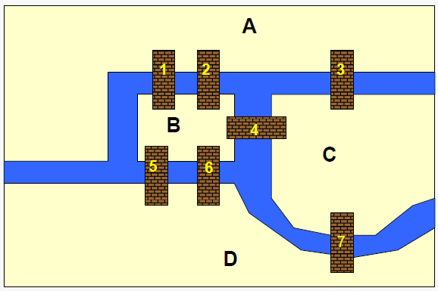
Collection Route Optimization
The 7 Bridges of Koenigsberg
Euler’s problem : Design a parade route for Köningsberg such that the parade would not cross any bridge over the River Pregel more than once and would return to its starting place.

Slide 7
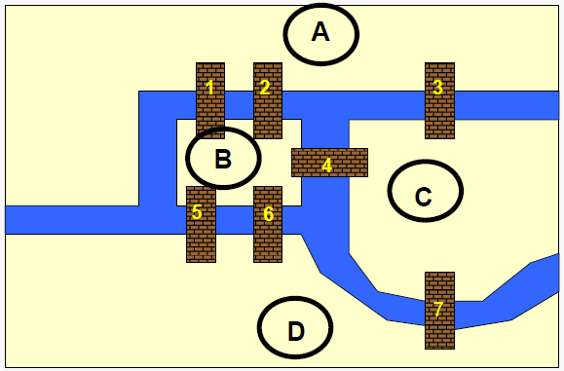
Collection Route Optimization
Conceptualization: Land masses are nodes/vertices
Euler showed that such a route was impossible for the king’s parade, but he generalized the problem by specifying what conditions are necessary to establish such a route, now known as an Euler’s route.

Slide 8
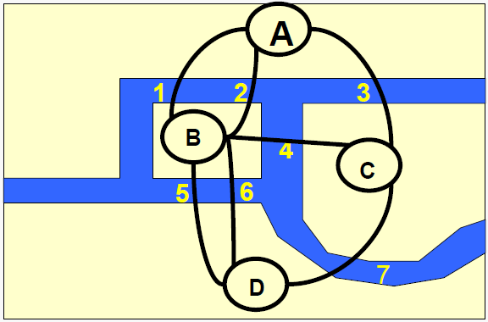
Collection Route Optimization
Conceptualization: Bridges are edges/links/arcs
Is there a walk starting at A and ending at A and passing through each edge exactly once?
Why isn’t there such a walk?

Slide 9
Collection Route Optimization
Eulerian Cycle: A closed walk that passes through each edge exactly once
Necessary condition: each node has an even degree
Degree of a node = number of edges incident to the node
Why necessary? The degree of a node ‘j’ is twice the number of times ‘j’ appears on the walk (except for the initial and final node of the walk)
Theorem: A graph has an Eulerian cycle if and only if the graph is connected and every node has even degree.
Eulerian Path: a walk that is not closed and passes through each edge exactly once
Theorem: A graph has an Eulerian path if and only if exactly two nodes have odd degree and the graph is connected.

Slide 10

Collection Route Optimization
Source: Ted-Ed; Lesson by Dan Van der Vieren, animation by Artrake Studio. https://www.youtube.com/watch?v=nZwSo4vfw6c

Slide 11
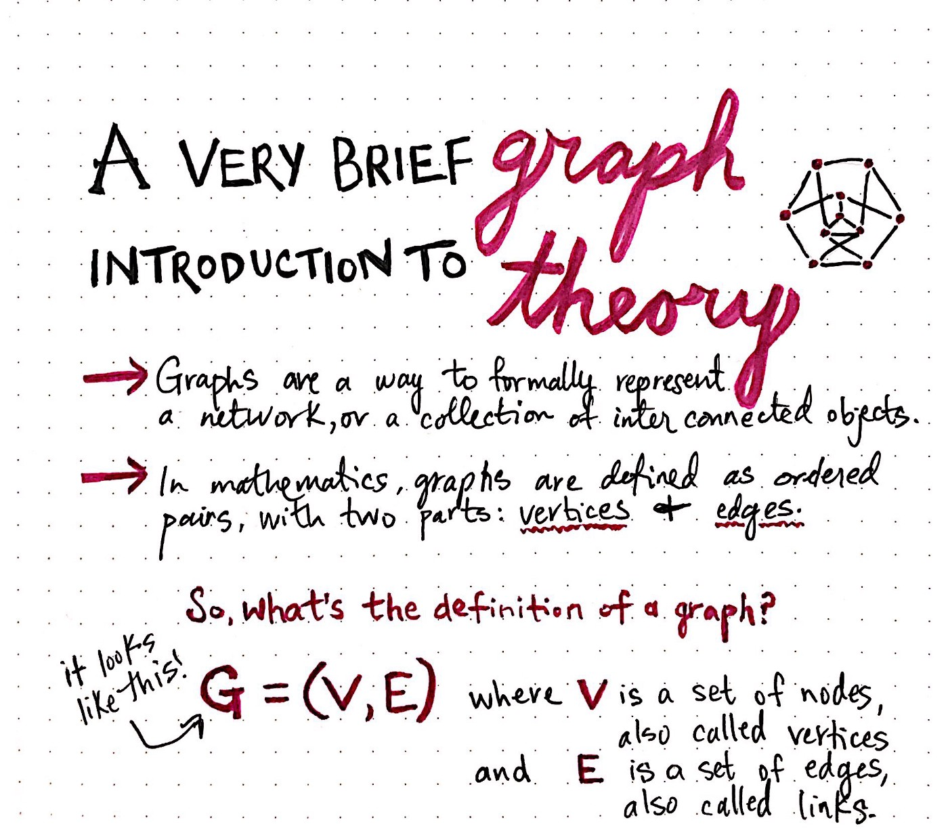
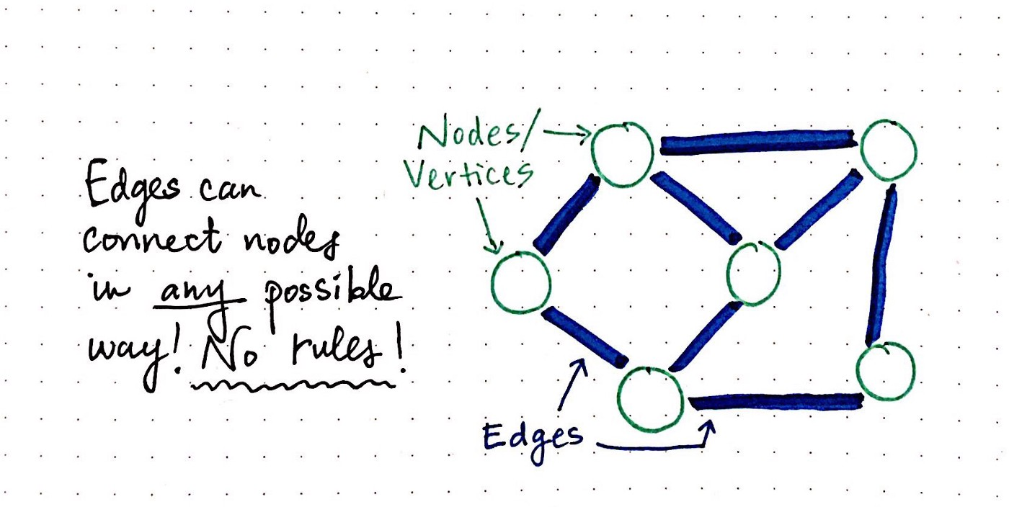
Concepts of Graph Theory
https://medium.com/basecs/a-gentle-introduction-to-graph-theory-77969829ead8

Slide 12
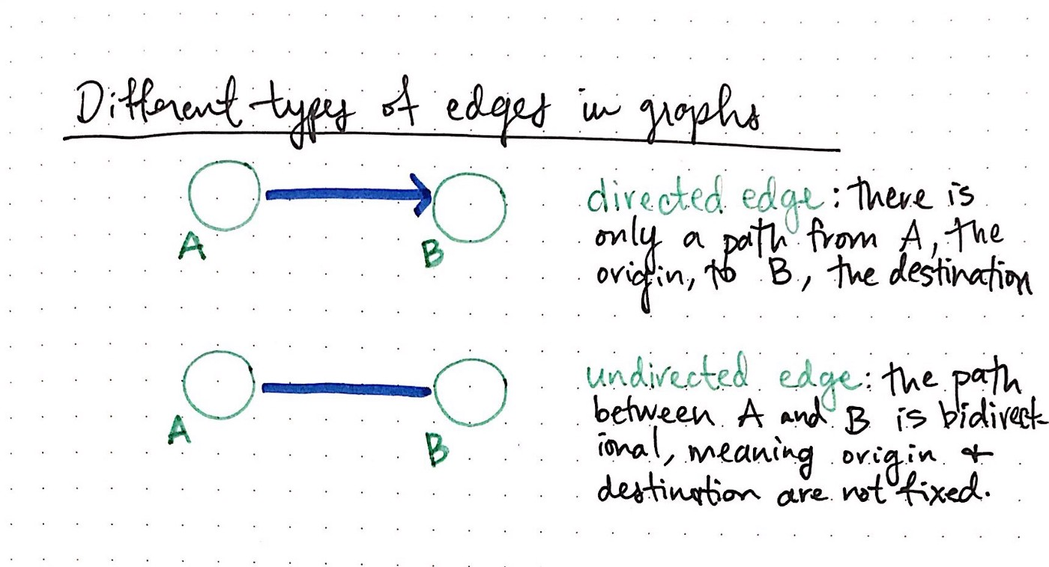
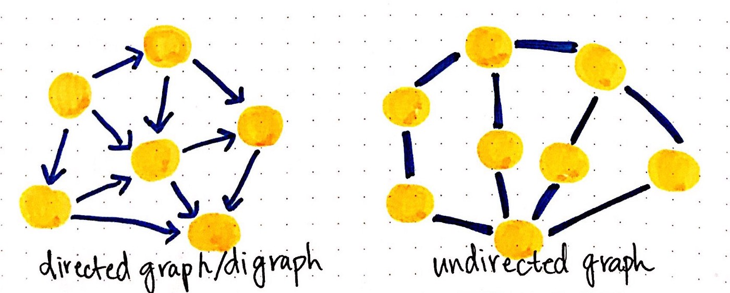
Concepts of Graph Theory
https://medium.com/basecs/a-gentle-introduction-to-graph-theory-77969829ead8

Slide 13
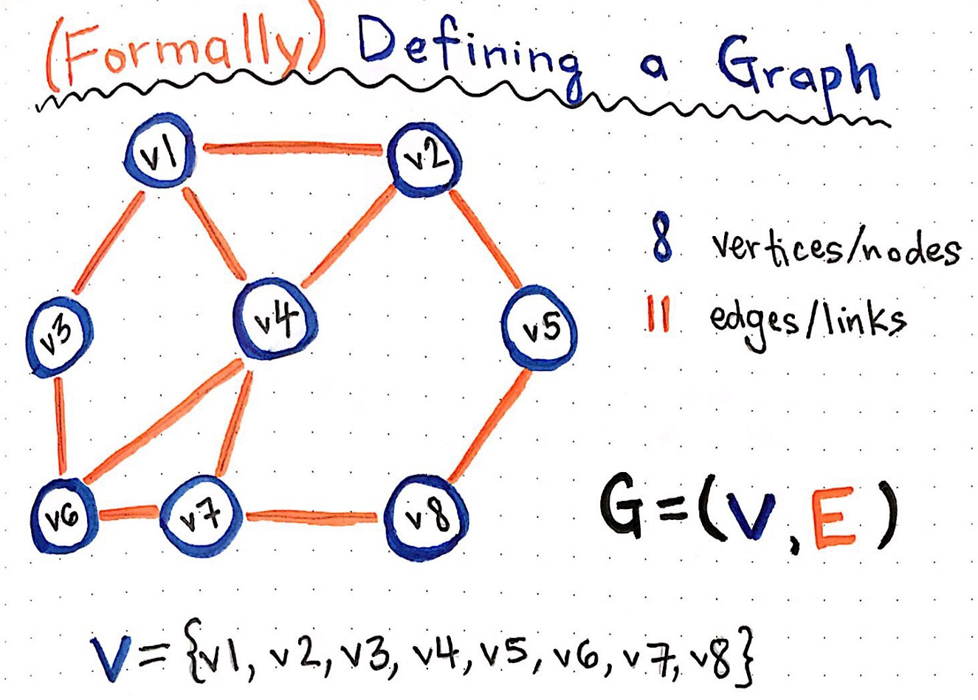
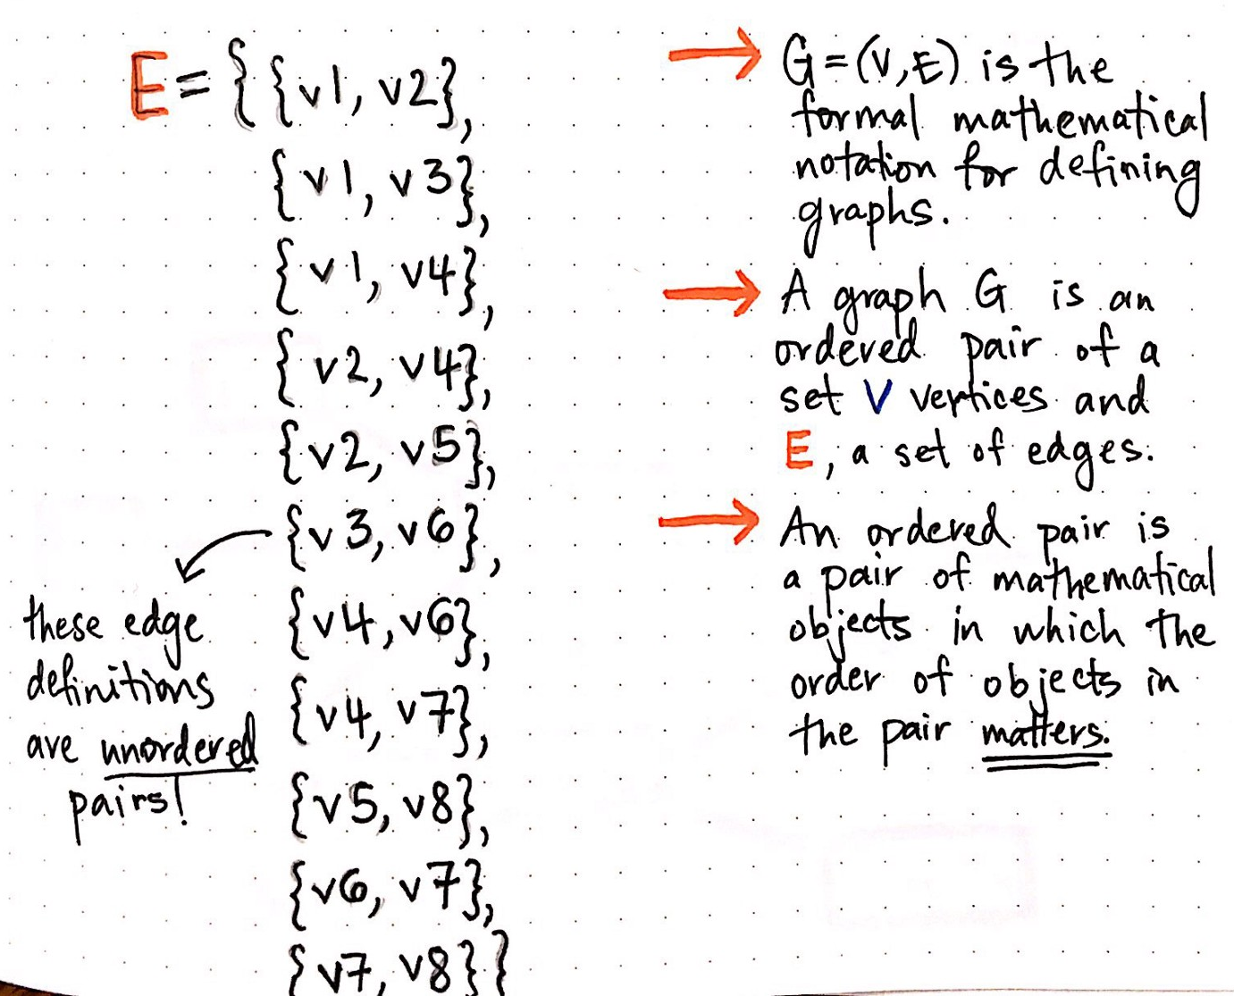
Concepts of Graph Theory
Example of an Undirected Graph
Edges can be unordered pairs
https://medium.com/basecs/a-gentle-introduction-to-graph-theory-77969829ead8

Slide 14
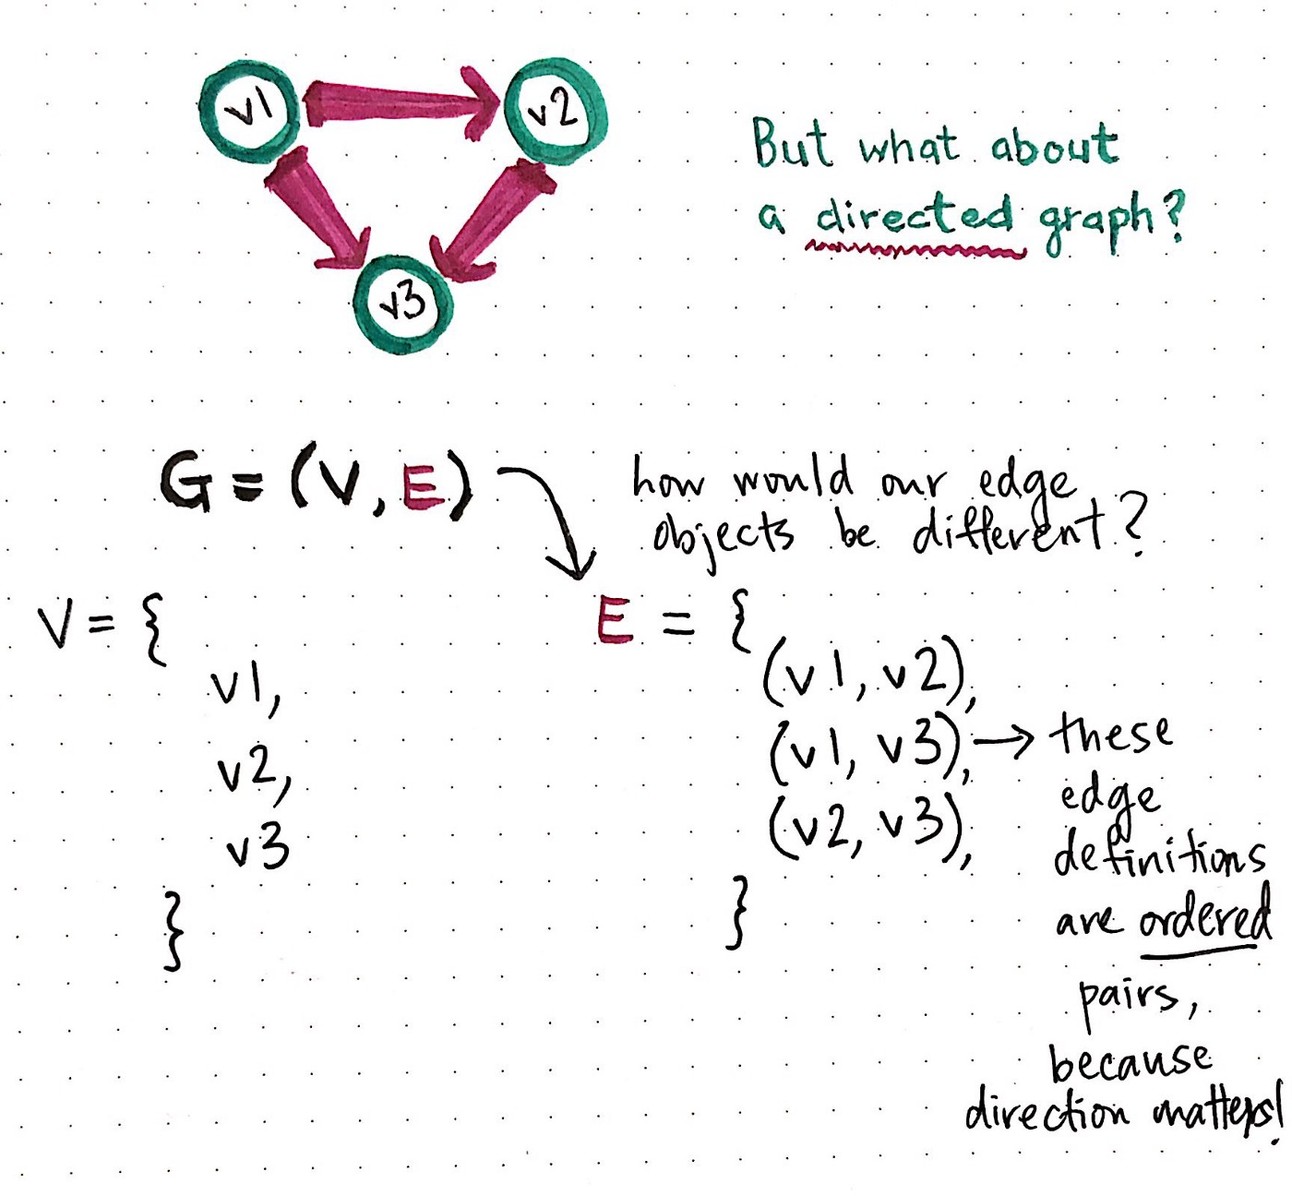
Concepts of Graph Theory
Example of an Directed Graph
https://medium.com/basecs/a-gentle-introduction-to-graph-theory-77969829ead8

Slide 15
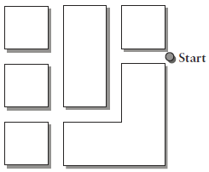
Sample Problem
Q1) A street network is shown in the figure below. If MSW from homes along these streets is to be collected by a vehicle that intends to travel down each street only once (i.e., waste being collected along both sides of the street), is an Euler’s tour possible?
If MSW is to be collected only on the block face (collected on only one side of a street, a situation that would typically occur in heavy traffic with large streets ), is an Euler’s tour possible?

